Slide 1


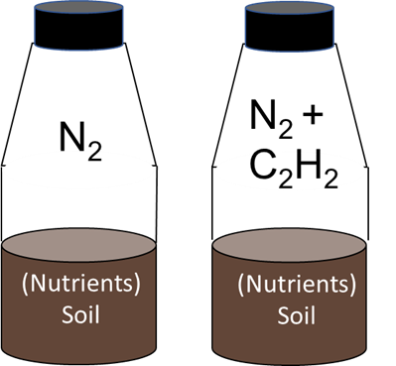
N₂O ratio
Denitrification
Soil pH
NO₃⁻ NO₂⁻ NO N₂O N₂
Natural sites in Oklahoma, USA
Modeling and Laboratory work
Soil pH vs. N₂O ratio

Slide 2
